Slide 1


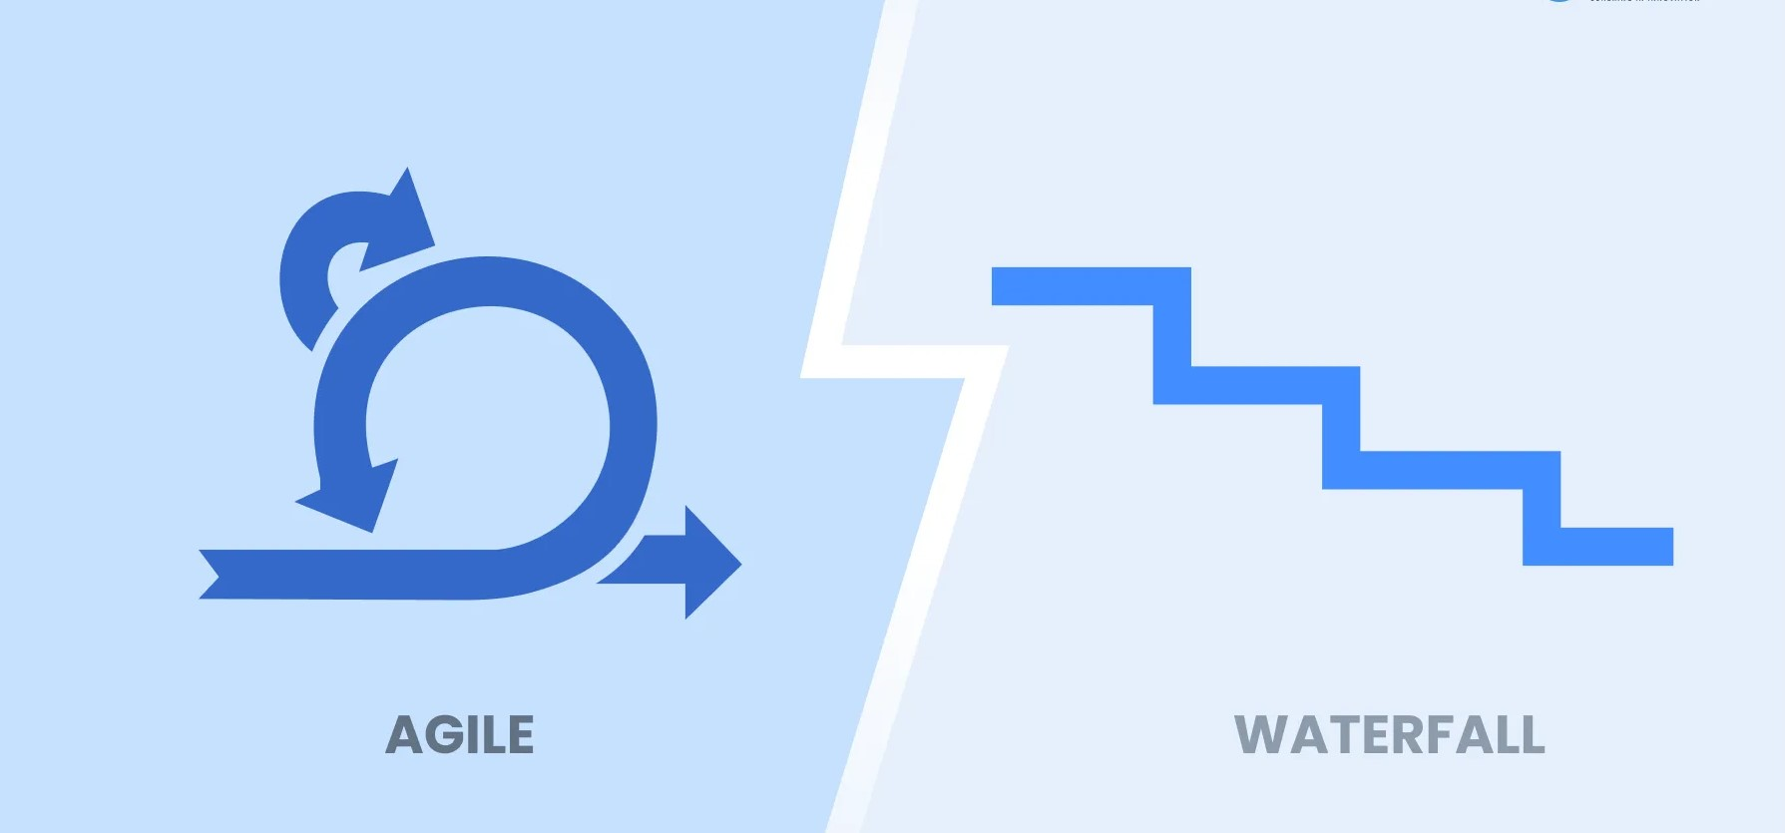
WAY TO ENTERPRISE
WATERFALL / AGILE METHODOLOGY
SCRUM FRAMEWORK

Slide 2

AGENDA
1
Waterfall Methodology
2
Agile Methodology
3
Scrum Framework
4
Demo Jira

Slide 3

WATERFALL METHODOLOGY

Slide 4
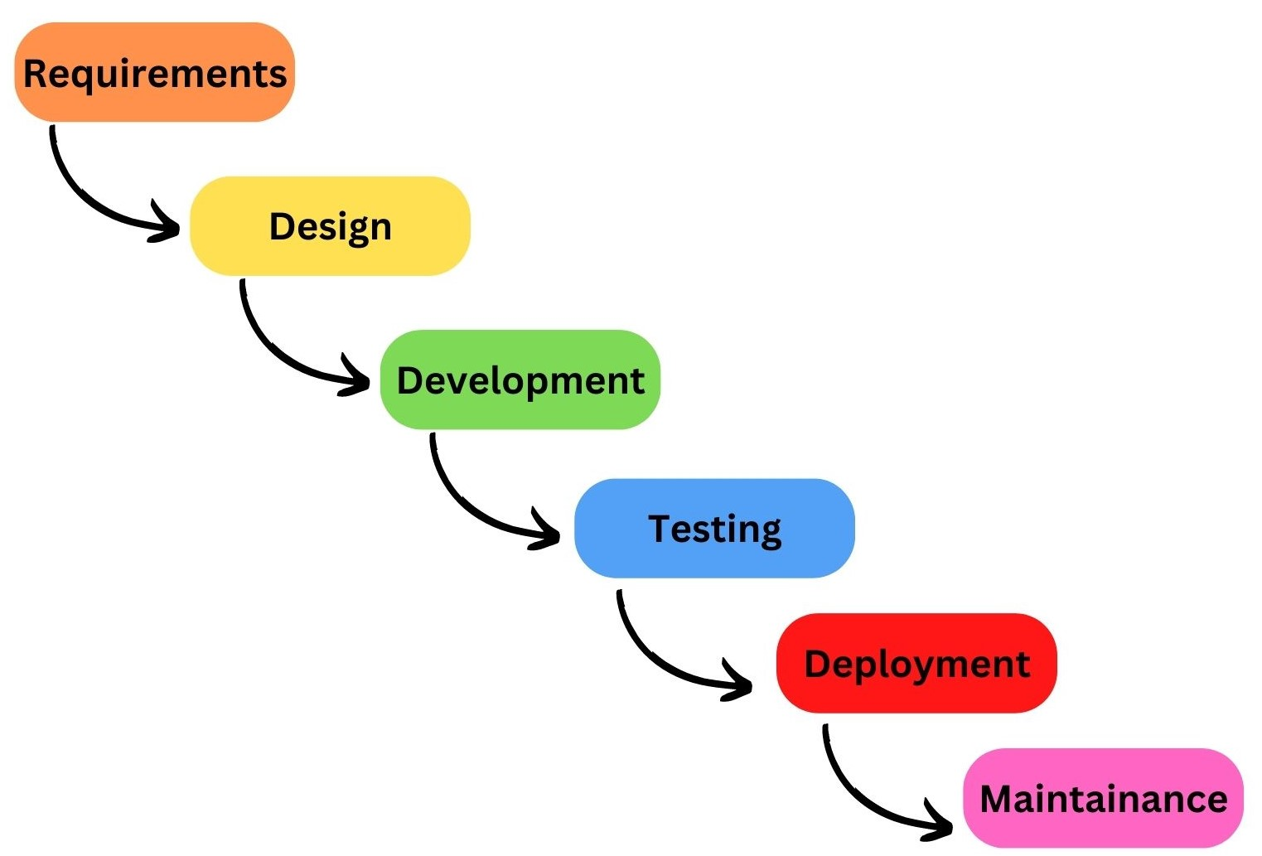
Waterfall Methodology

Slide 5
Waterfall Methodology
Waterfall methodology is a traditional methodology in which tasks and phases are completed in a linear, sequential manner, and each stage of the project must be completed before the next begins.
The end result is clearly established from the beginning of the project.

Slide 6
Advantages of the Waterfall methodology
Determine the requirements.
Determine the end goal.
Fixed timeline and budget.
Easy to manage

Slide 7
Disadvantages of the Waterfall methodology
Clients/Customer are not involved in the stages.
Difficult to accept changes.
There is not collaboration, interaction between members, the team.
There is not suitable for long and complex projects.

Slide 8
AGILE METHODOLOGY

Slide 9
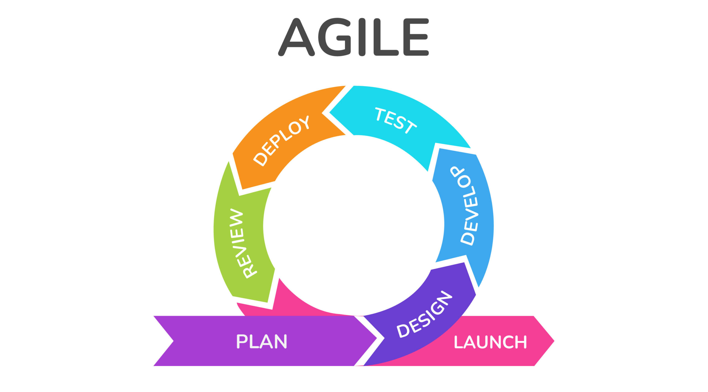
Agile Methodology

Slide 10
Agile Methodology
Agile methodology is a project management approach that involves breaking the project into phases and emphasizes continuous collaboration, iterative work with frequent.

Slide 11
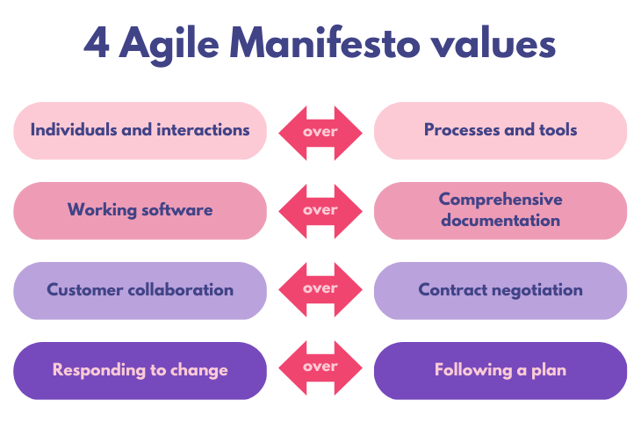

Slide 12
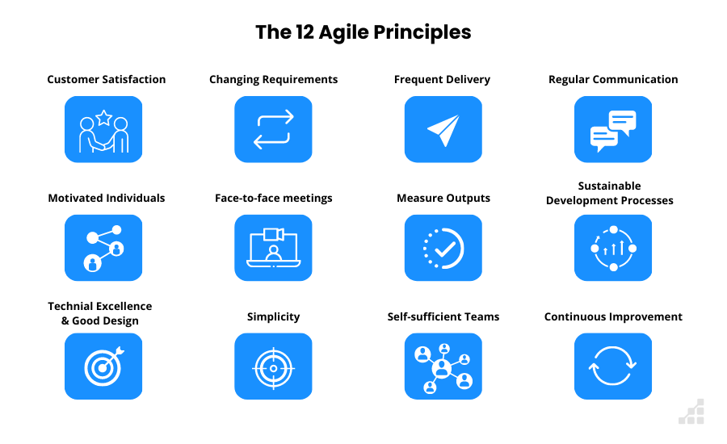

Slide 13
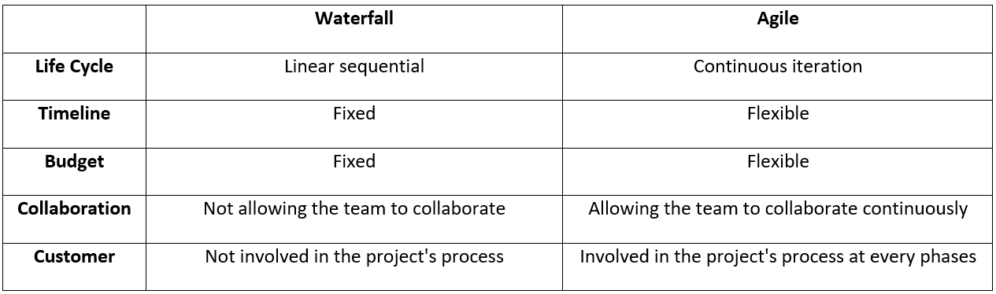
Difference Between Methodologies

Slide 14
SCRUM FRAMEWORK

Slide 15
What is Scrum?
Scrum is a framework within which people can solves complex adaptive problems, while productively and creatively delivering products of the highest possible quality.
The scrum framework consists of scrum team and their associated roles, events, artifacts and rules.

Slide 16
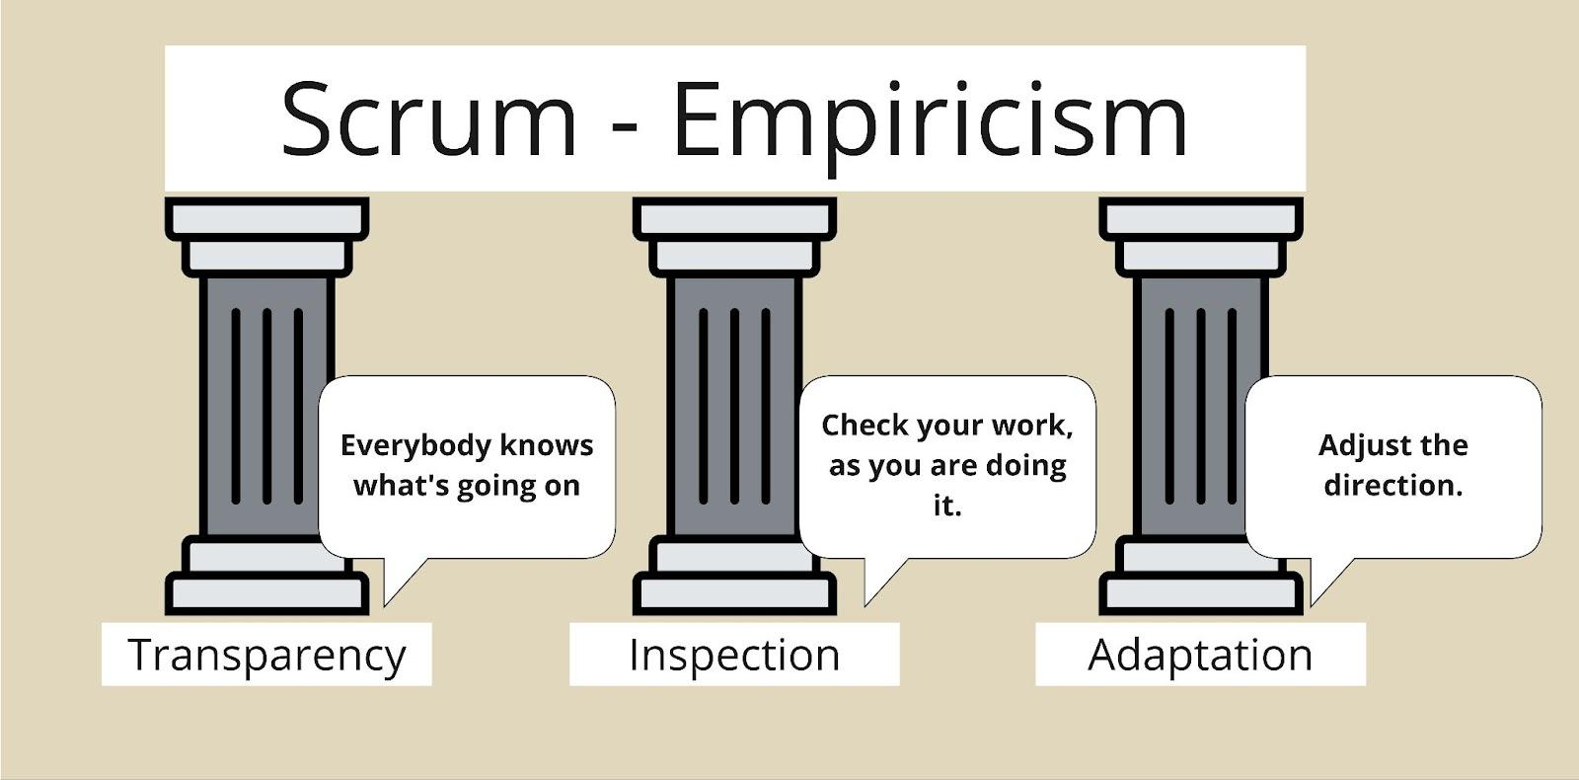

Slide 17
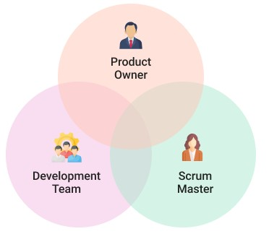
Scrum Team

Slide 18
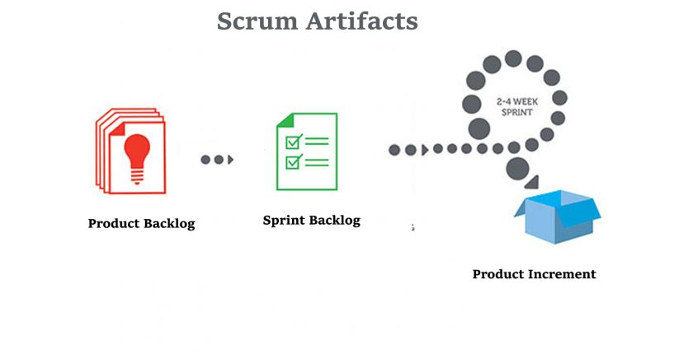

Slide 19
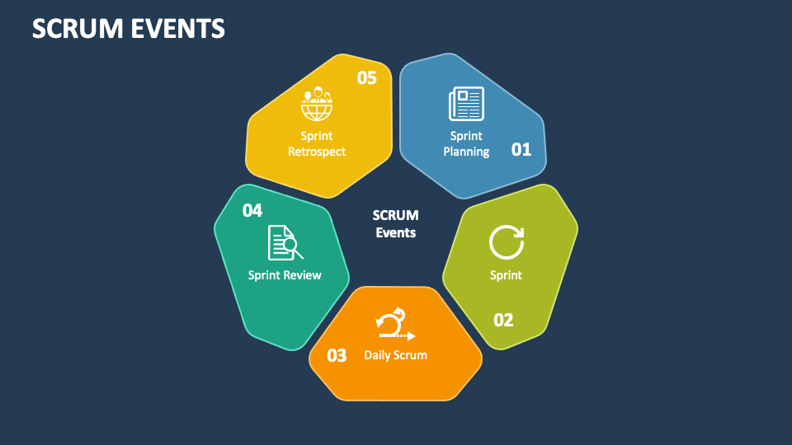
Scrum Events
Notes:
Daily scrum
• What did I do yesterday? • What do I plan to do today? • Are there any obstacles?

Slide 20
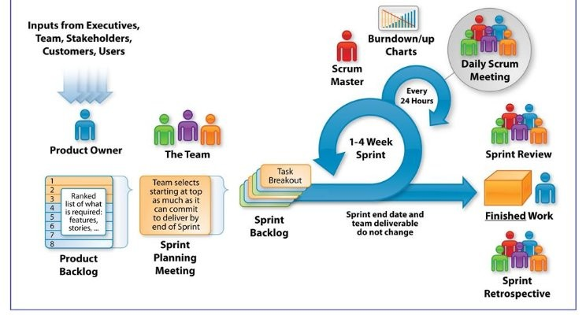

Slide 21
DEMO JIRA

Slide 22
User story
A short description of a feature that a customer is asking for.
Usually written in the form
As a <role>
I want <goal>
So that <reason>

Slide 23
Story point
A measuring unit of the amount of work required to complete the story.
One story point can stand for period of time

Slide 24
Thank You!

